Slide 1
Using measurement theory and data analysis to improve the quality of assessment
Robert Coe
Evidence Based Education and Education Endowment Foundation
Putting educational research into practice in HE Mathematics and Statistics teaching
Bayes Centre, University of Edinburgh, Monday 29th April 2019

Slide 2
Using measurement theory and data analysis to improve the quality of assessment
What do I mean by ‘quality of assessment’?
A bit of measurement theory
Examples of training and data analysis that suggest this might be helpful

Slide 3
What is
‘Quality of assessment’?
I

Slide 4
Quality of assessment
Validity
Reliability
Fitness for purpose(s)

Slide 5
Designing assessments
What impact do we want this assessment to have?
What inferences/decisions do we need to make?
What interpretations are intended?
What reporting will support these interpretations?
What data will be required to produce such reports?
What kind of assessment process can produce such data?

Slide 6
Some purposes of assessment
To motivate learning
  Anticipation of being tested; goal progress; cueing
To provide practice
  Retrieval; elaborative interrogation
To diagnose specific learning needs
  Inform pedagogical decisions: continue, check, reteach?
To monitor progress
To forecast likely future performance
To allocate students to categories
  Selection; certification; groups; grades; actions

Slide 7
Some purposes of assessment
(not dependent on measure)
To motivate learning
  Anticipation of being tested; goal progress; cueing
To provide practice
  Retrieval; elaborative interrogation
To diagnose specific learning needs
  Inform pedagogical decisions: continue, check, reteach?
To monitor progress
To forecast likely future performance
To allocate students to categories
  Selection; certification; groups; grades; actions

Slide 8
Assessment should be ‘just right’
(Goldilocks principle)
Not too narrow
(Construct under-representation)
  the measure fails to capture important aspects of the construct (e.g. it leaves out speaking and listening, contains too little higher-order thinking, focuses on numeracy but claims to assess maths, etc)
Not confounded
(Construct-irrelevant variance)
  the measure is influenced by things other than just the construct (e.g. a maths test that requires high levels of reading ability, a reading test that requires background knowledge about cricket, an assessment of writing that is influenced by neatness of handwriting, etc)

Slide 9
Construct-irrelevant variance (1)
Method variance
Scores from assessments that use the same method (eg MCQs, essays, self-report qnres) tend to correlate, even if the traits they measure are unrelated
  Part of the measure is determined by the way that person responds to that type of question (willingness to guess, verbal fluency, social desirability, acquiescence – response sets)
Combine multiple methods to minimise these confounds

Slide 10
Construct-irrelevant variance (2)
Bias in teacher assessment vs standardised tests
Teacher assessment is biased against
  Pupils with SEN
  Pupils with challenging behaviour
  EAL & FSM pupils
  Pupils whose personality is different from the teacher’s
Teacher assessment tends to reinforce stereotypes
  Eg boys perceived to be better at maths
  ethnic minority vs subject
Notes:
Harlen W (2004) A systematic review of the evidence of reliability and validity of assessment by teachers used for summative purposes. In: Research Evidence in Education Library. London: EPPI-Centre, Social Science Research Unit, Institute of Education, University of London. [http://eppi.ioe.ac.uk/cms/Default.aspx?tabid=116&language=en-US]
Bennett et al., 1993
Peter Tymms: ‘Teachers show bias to pupils who share their personality’. The Conversation 25 Feb 2015 https://theconversation.com/teachers-show-bias-to-pupils-who-share-their-personality-38018
Burgess, S. and Greaves, E (2009) Test Scores, Subjective Assessment and Stereotyping. Centre for Market and Public Organisation, Bristol University. Working Paper No. 09/221. http://www.bristol.ac.uk/media-library/sites/cmpo/migrated/documents/wp221.pdf
of Ethnic Minorities

Slide 11
What is reliability?
Reliability = expected correlation between scores from independent replications of an assessment process that differ in characteristics that we want to treat as interchangeable
  Different occasions: test-retest reliability
  Different markers: inter-rater reliability
  Different test forms: parallel forms reliability
  Different samples of items: internal consistency (Cronbach’s alpha), or just ‘reliability’
  Different runs of a comparative judgement process: ‘reliability’
The same word is (rather confusingly) used to mean all these things!

Slide 12
Interpretations of reliability
Reliability can be interpreted as
  Replicability: how consistently would an observed score be reproduced if elements of the measurement process that we wish to treat as arbitrary, unimportant and interchangeable were changed?
  Accuracy: with what precision can an observed score be taken as an estimate of a true score?
  Weight: How much trust/emphasis should this score carry (in a rational synthesis of available evidence)?

Slide 13
Reliability vs Validity?
Reliability is an aspect of validity
  For most uses and interpretations of observed scores (ie for validity), they need to be replicable, consistent, accurate (ie reliable)
  Reliability is a component of construct-irrelevant variance – the random part
  Some things that make an assessment more valid (eg including authentic writing tasks; using mixed methods) can also make it less reliable.
  Some things that make an assessment more reliable (eg more short, objective items of a similar type) can also make it less valid.

Slide 14
Reliability = alpha?
Cronbach’s coefficient alpha
  Is easily calculated without having to collect additional data
  Captures only a part of the ‘random’ error in most measures
  Is not really an indicator of the ‘internal consistency’ of the items (look at inter-item correlations and other dimensionality analyses)
  Rules of thumb ‘acceptable’ or ‘excellent’ thresholds for alpha are only for people who don’t understand assessment: it depends what you want to use it for (and the cost of being wrong)
Notes:
Lance, C.E., Butts, M.M., & Michels, L.C. (2006). The sources of four commonly reported cutoff criteria: What did they really say? Organizational Research Methods, 9 (2), 202-220.
Henson, R.K. (2001). Understanding internal consistency reliability estimates: A conceptual primer on coefficient alpha. Measurement and Evaluation in Counseling and Development, 34 (3), 177-189.

Slide 15
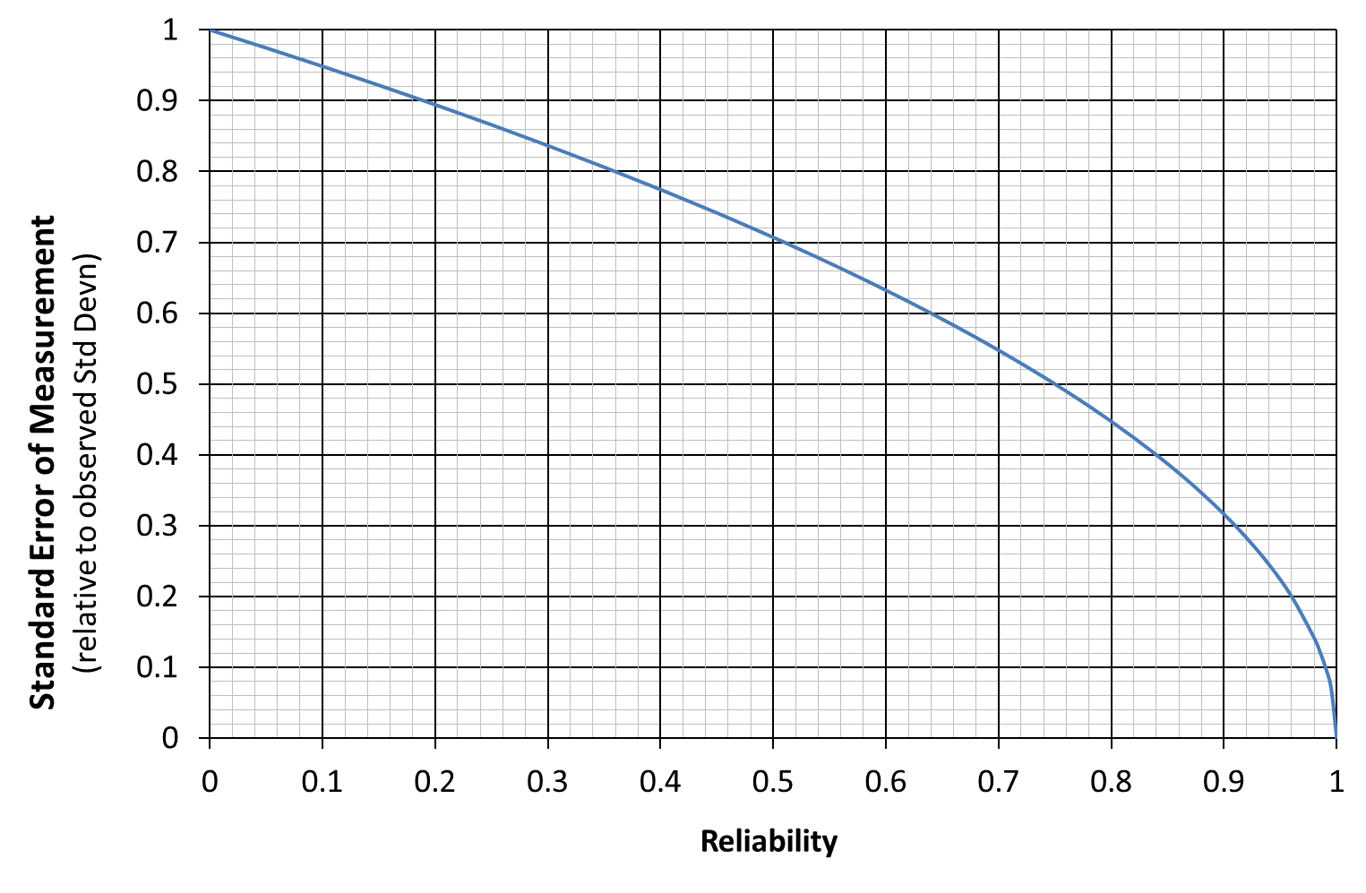
How big is the standard error?
SEM = σ_{E} = σ_{X} √(1-ρ)

Slide 17
Measurement theory
II
17

Slide 18
Item Response Theory (IRT)
A single ‘latent trait’ is used to measure both ability (of persons) and difficulty (of items)
Values of person ability and item difficulty are estimated iteratively using maximum likelihood
For each item, a formula gives the probability that persons of different abilities will get it right: this can be shown as an Item Characteristic Curve (ICC)

Slide 19
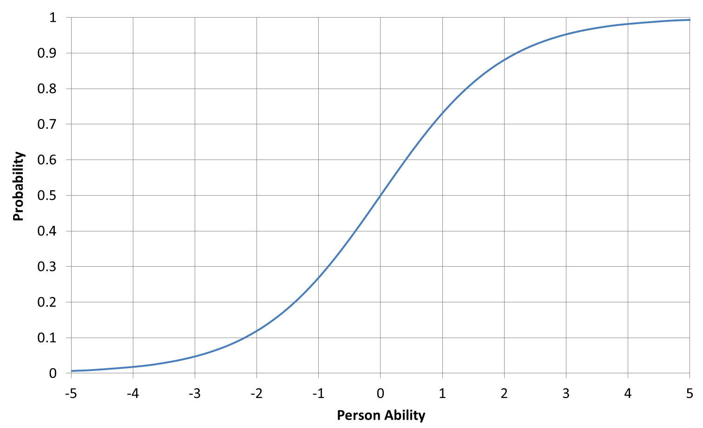
Item Characteristic Curve

Slide 20
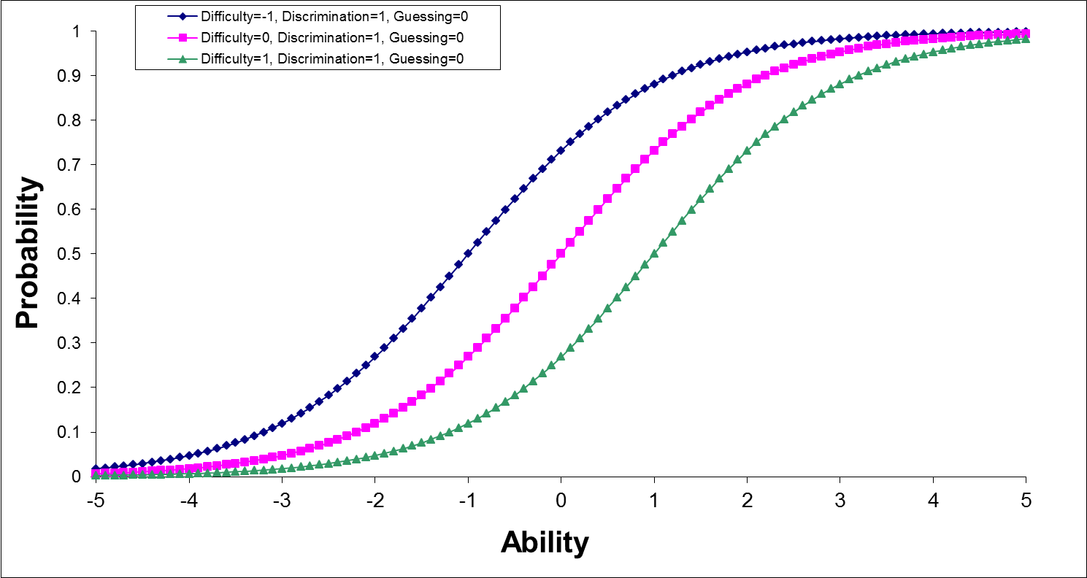
Items differ in their …
Difficulty (1-parameter)

Slide 21
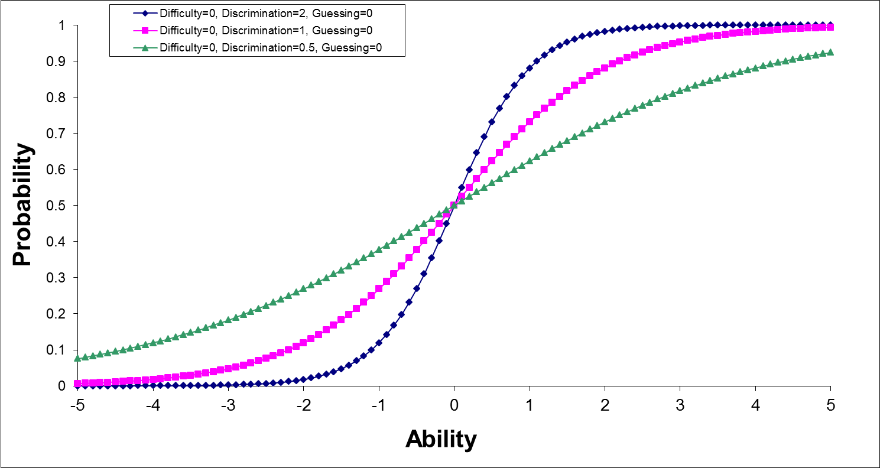
Items differ in their …
Discrimination (2-parameter)

Slide 22
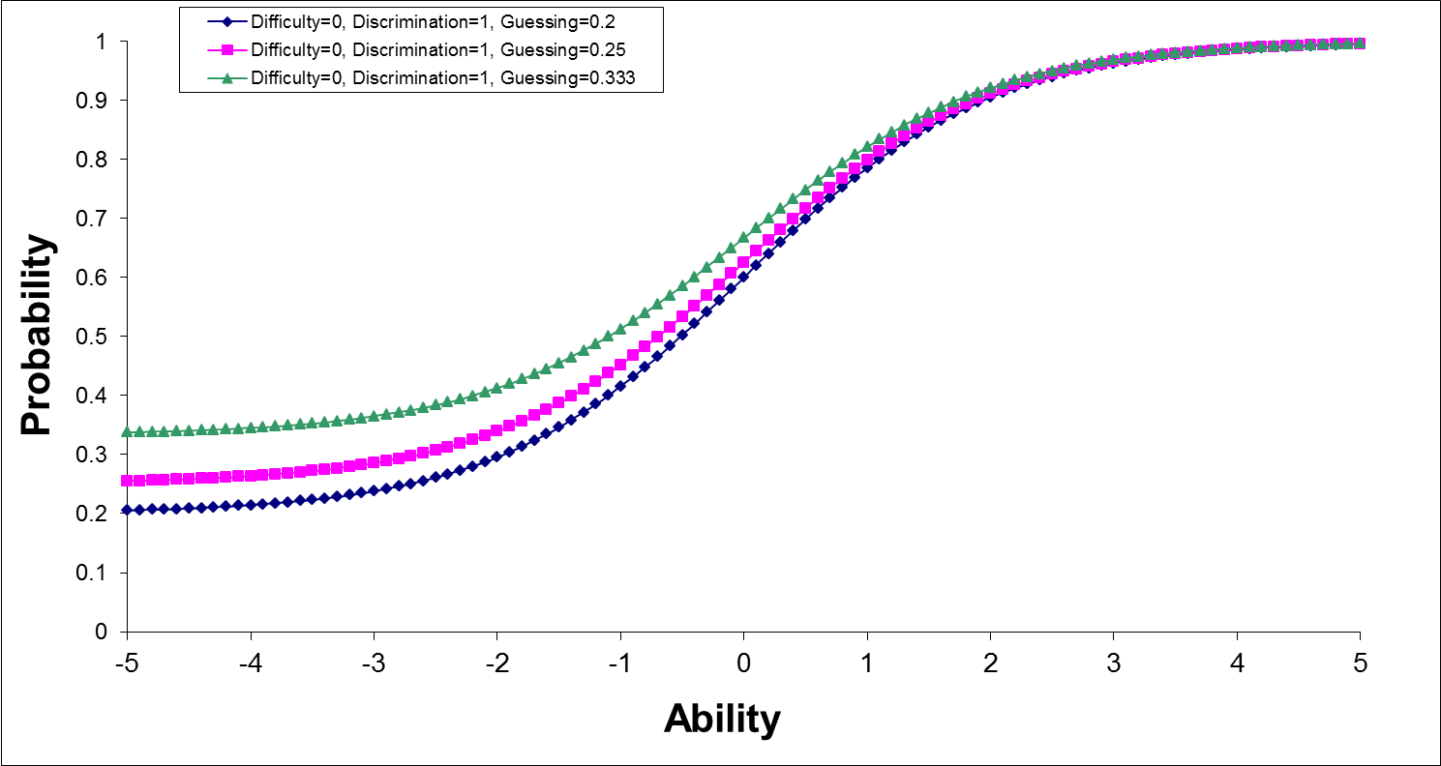
Items differ in their …
Guessing (3-parameter)

Slide 23
Local independence
Probability of getting any question right is independent of answers given to any other question (for the same ability)
This would be violated if
  Questions share a common passage or stimulus
  Questions repeat or overlap too much
  The answer to one question depends on another
This is a requirement for all IRT models
One solution is to group dependent items into a ‘testlet’ and use partial credit model

Slide 24
Basic Rasch model
(1-parameter logistic)
(
Prob (success)
)
logit(p) =
ln
= Ability - Difficulty
Prob (failure)
A person’s probability of success depends only on their ability and the difficulty of the item (and chance)
All items have the same discrimination (none of the ICCs intersect)
For candidates who have attempted the same questions, their total score is ‘sufficient’ (ie fully defines the Rasch measure): people with the same total will have the same Rasch measure.

Slide 25
Requirements for measurement
Unidimensionality
  Performance is determined only by true score (on some latent trait) and chance, no other factor can explain any variation
Instrument independence
  Measure should be the same, whichever items are used (or any subset)
Equal interval scale
  The same interval between measures corresponds to the same probability
  Intervals can be added (conjoint additive)
Only Rasch has these

Slide 26
Examples of using this in practice
III
26

Slide 27
Experiences so far
Developing assessments in CEM
Teaching MSc in Educational Assessment
Training examiners
Quantum
Assessment Academy
R tool

Slide 28
Training examiners
4 days training for 650 Principal Examiners, Chairs and Chiefs
About 200 passed quite a tough exam at the end
Rasch PCM can be applied to GCSE and A level data and give useful insights

Slide 29
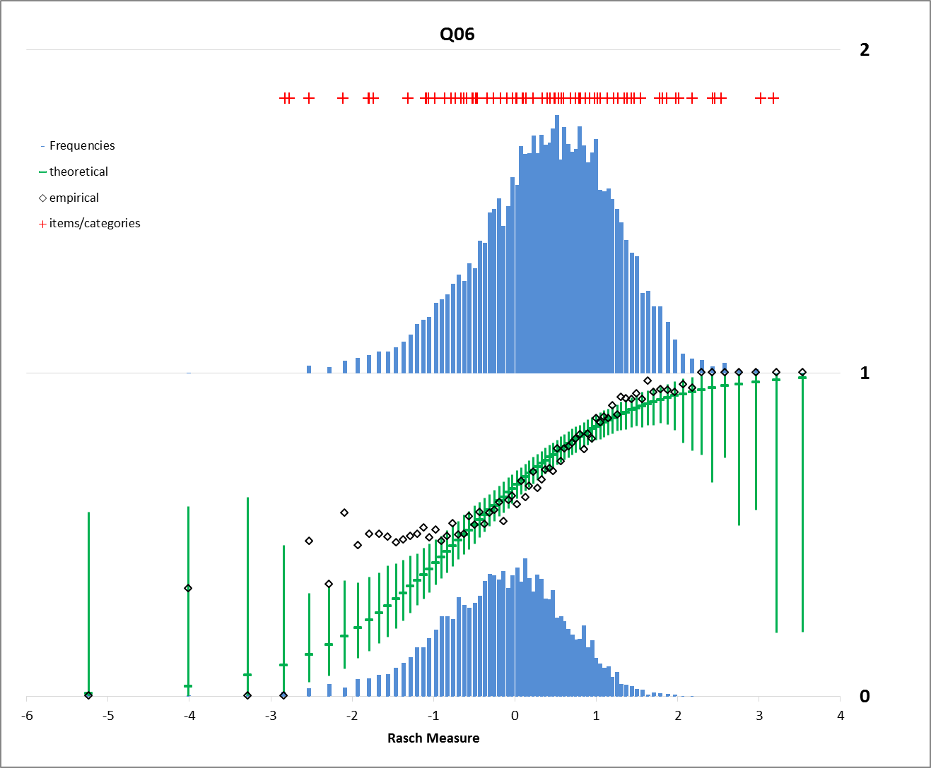

Slide 30
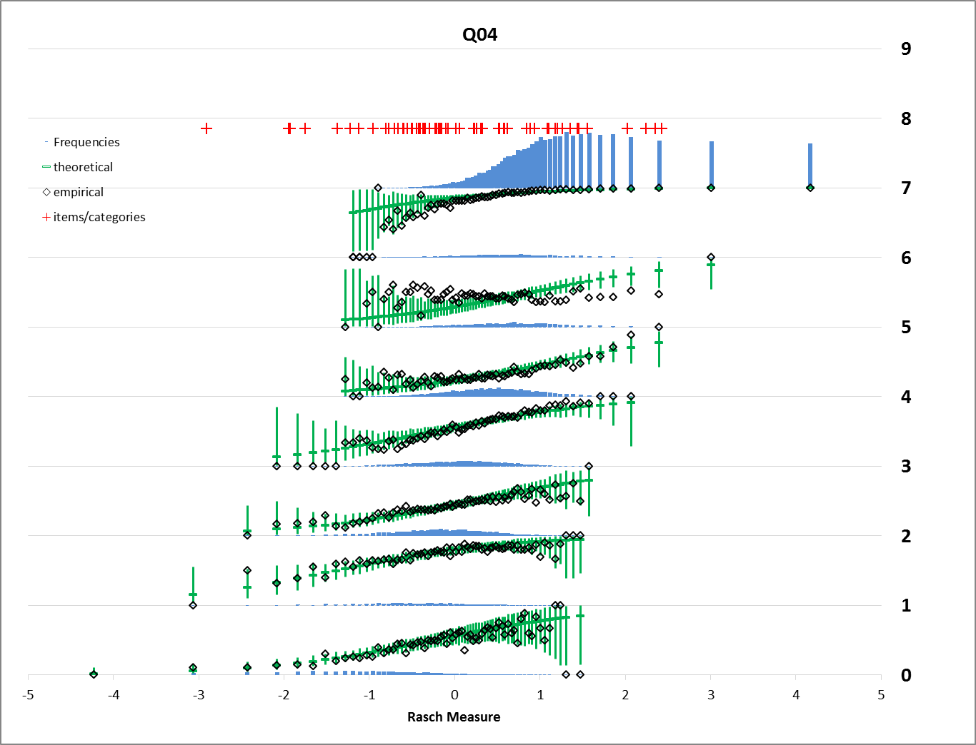

Slide 31
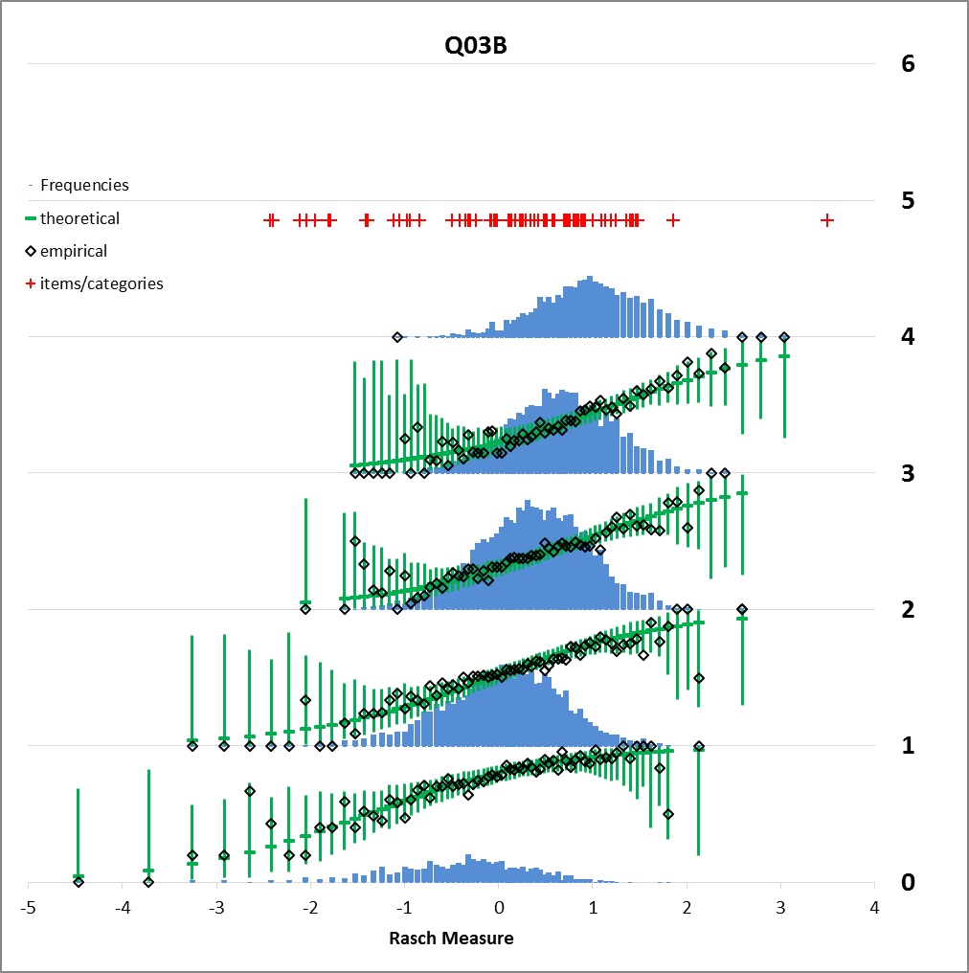

Slide 32
Quantum
Online item bank of MCQs
Analysed a subset
  3k items with >500 responses, 23k persons with >50
92% of items have good or OK fit & discrimination
Almost none have genuine distractors/misconceptions
Feedback to authors is tricky

Slide 33
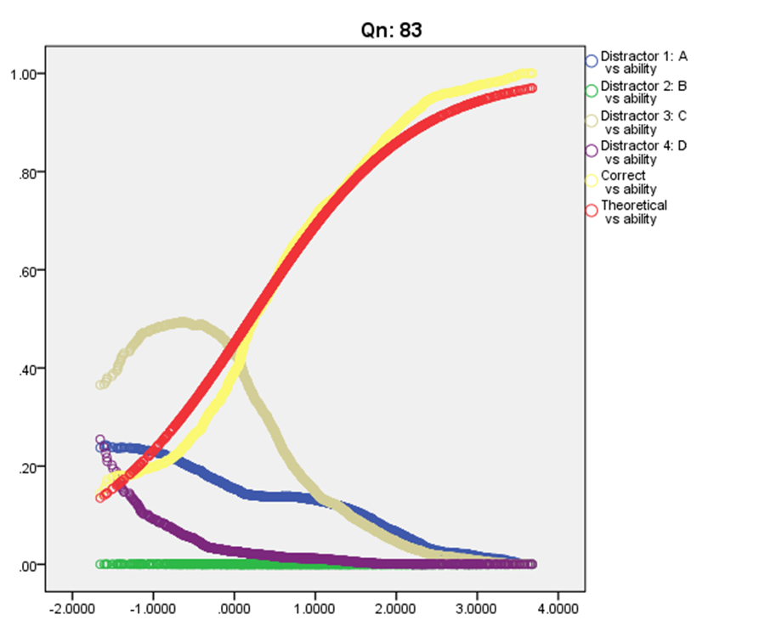

Slide 34
Assessment Academy
25 NE teachers (Y1-Y13, range of schools, subjects, volunteers/conscripts)
4 days training
Created tools in response to demand:
  ‘Reliability calculator’,
  ‘Multi-mark reliability calculator’
‘How good is my test?’ prototype produced

Slide 35
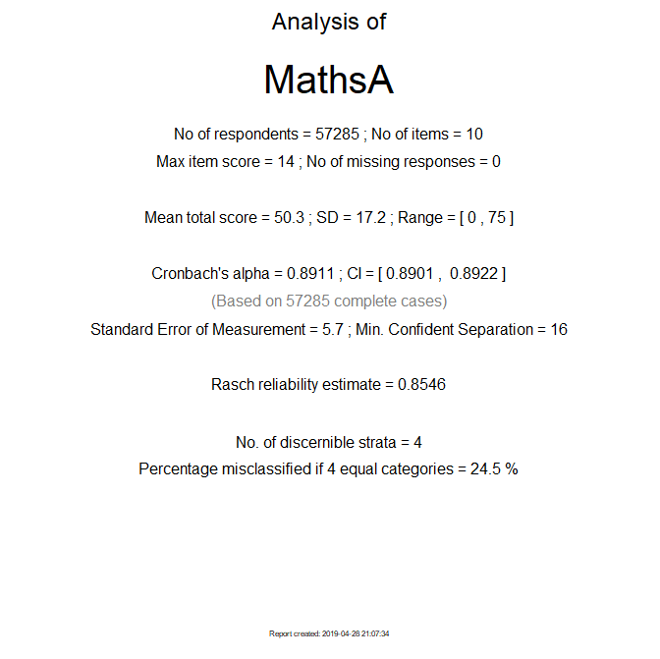

Slide 36
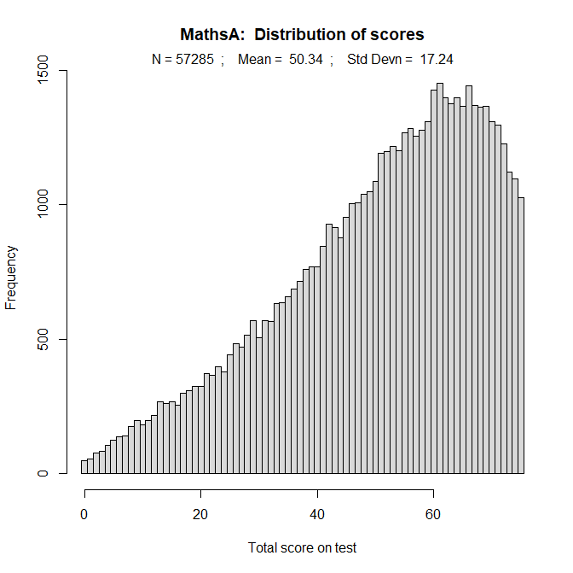

Slide 37
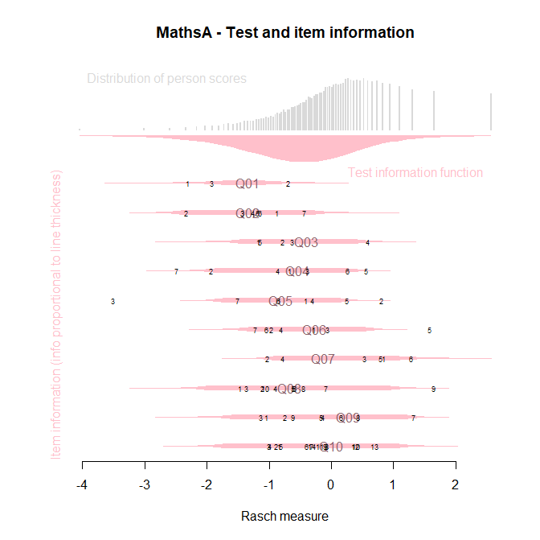

Slide 38
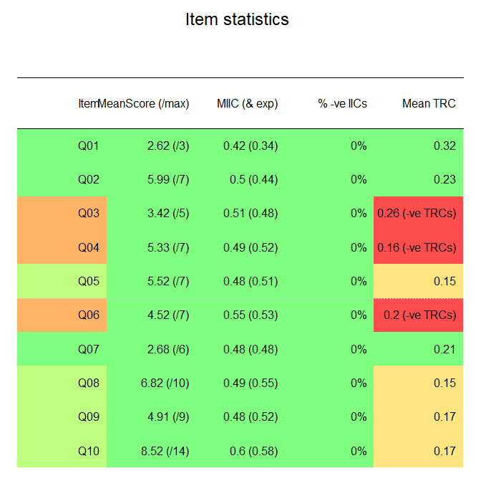

Slide 39
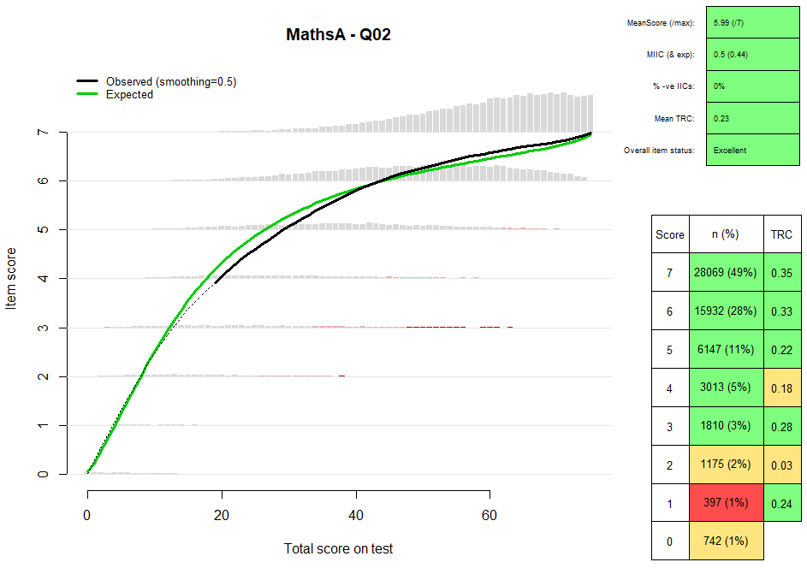

Slide 40
